Slide 1

SYSTEMS ANALYSIS & DESIGN
Lesson 3
Project Management
By
Samuel Agana

Slide 2

Learning Objectives
Understand how projects are initiated and selected, define a business problem, and determine the feasibility of a proposed project.
Evaluate hardware and software and the way it supports human interactions with technology.
Forecast and analyze tangible and intangible costs and benefits.
Manage a project by preparing a budget, creating a work breakdown structure, scheduling activities, and controlling the schedule and costs.
Build and manage a project team
Professionally write and present an effective systems proposal, concentrating on both content and design

Slide 3
Project Management Fundamentals
Project initiation
Determining project feasibility
Activity planning and control
Project scheduling
Managing systems analysis team members

Slide 4
Project Initiation
Project initiation is the first phase of the project management life cycle and in this stage, companies decide if the project is needed and how beneficial it will be for them. The two metrics that are used to judge a proposed project and determine the expectations from it are the business case and feasibility study.
Problems in the organization
Problems that lend themselves to systems solutions
Opportunities for improvement
Caused through upgrading, altering, or installing new systems
Notes:
Project initiation is the first phase of the project management life cycle and in this stage, companies decide if the project is needed and how beneficial it will be for them. The two metrics that are used to judge a proposed project and determine the expectations from it are the business case and feasibility study.

Slide 5
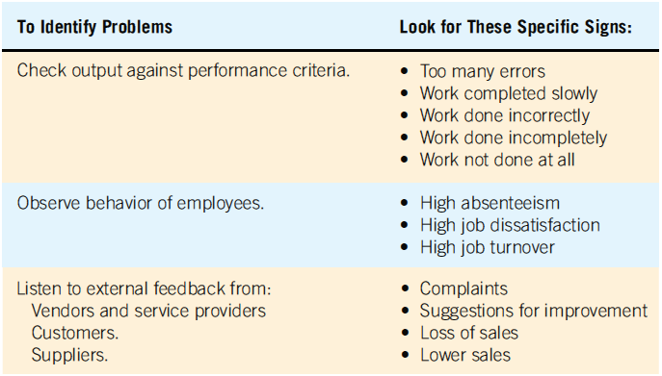
Checking Output, Observing Employee Behavior, and Listening to Feedback Are All Ways to Help the Analyst Pinpoint Systems Problems and Opportunities (Figure 3.1)

Slide 6
Problem Definition
Problem statement
Paragraph or two stating the problem or opportunity
Issues
Independent pieces pertaining to the problem or opportunity
Objectives
Goals that match the issues point-by-point
Requirements
The things that must be accomplished along with the possible solutions, and constraints, that limit the development of the system
Use the problem definition to create a preliminary test plan
Notes:
Issues are the current situation, objectives are the desired situation.
Requirements may include security, usability, government requirements and so on.
Constraints might be budget restrictions or time limitations.

Slide 7
Selection Of Projects
Backing from management
Appropriate timing of project commitment
Possibility of improving attainment of organizational goals
Practical in terms of resources for the system analyst and organization
Worthwhile project compared with other ways the organization could invest resources
Notes:
Backing from management—absolutely nothing can be accomplished without the endorsement of the people who eventually will foot the bill.
Appropriate timing of project commitment—can a time commitment be made for installation of new systems or improvement to existing ones.
Possibility of improving attainment of organizational goals—the project should put the organization on target, not deter it from its goals.
Practical in terms of resources for the system analyst and organization—is there expertise and resources to carry out the project.
Worthwhile project compared with other ways the organization could invest resources—when a business commits to one project it is committing resources that are unavailable for other projects.

Slide 8
Selection of Projects: Improving Attainment of Organizational Goals
Improving corporate profits
Supporting the competitive strategy of the organization
Improving cooperation with vendors and partners
Improving internal operations support
Improving internal decision support so that decisions are more effective
Improving customer service
Increasing employee morale

Slide 9
Defining Objectives
Many possible objectives exist including:
Speeding up a process
Streamlining a process
Combining processes
Reducing errors in input
Reducing redundant storage
Reducing redundant output
Improving system and subsystem integration
Notes:
Improvements to systems can be defined as changes that will result in incremental but worthwhile benefits.

Slide 10
Determining Feasibility
Defining objectives
Determining resources
Operationally
Technically
Economically
The feasibility study must be highly time compressed, encompassing several activities in a short span of time.

Slide 11
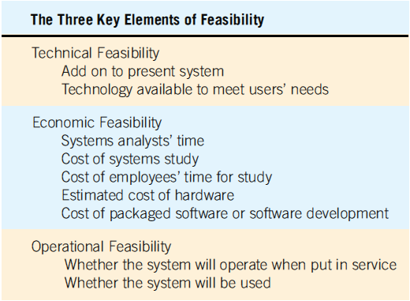
The Three Key Elements of Feasibility Include Technical, Economic, and Operational Feasibility (Figure 3.3)
Notes:
A project must be feasible in all three ways to merit further development.

Slide 12
Technical Feasibility
Can current technical resources be upgraded or added to in a manner that fulfills the request under consideration?
If not, is there technology in existence that meets the specifications?
Sometimes add-ons are costly and not worthwhile, because they meet needs inefficiently.

Slide 13
Economic Feasibility
Economic feasibility determines whether value of the investment exceeds the time and cost
Includes:
Analyst and analyst team time
Business employee time
Hardware
Software
Software development
If short-term costs are not overshadowed by long-term gains or produce no immediate reduction in operating costs, the system is not economically feasible.

Slide 14
Operational Feasibility
Operational feasibility determines if the human resources are available to operate the system once it has been installed
Users that do not want a new system may prevent it from becoming operationally feasible
If users are satisfied with current system resistance to implementing a new system will be strong.
If users are dissatisfied with the current system and have expressed a need for change chances are that the new system will be used.

Slide 15
Estimating Workloads
Systems analysts formulate numbers that represent both current and projected workloads for the system so that any hardware obtained will possess the capability to handle current and future workloads
The newly-proposed system should cut down required human and computer time.

Slide 16
Ascertaining Hardware and Software Needs
Steps used to determine hardware and software needs:
Inventory computer hardware currently available
Estimate current and future system workloads
Evaluate available hardware and software
Choose the vendor
Acquire the computer equipment
Only when systems analysts, users, and management have a good grasp of what kinds of tasks must be accomplished can hardware options be considered.

Slide 17
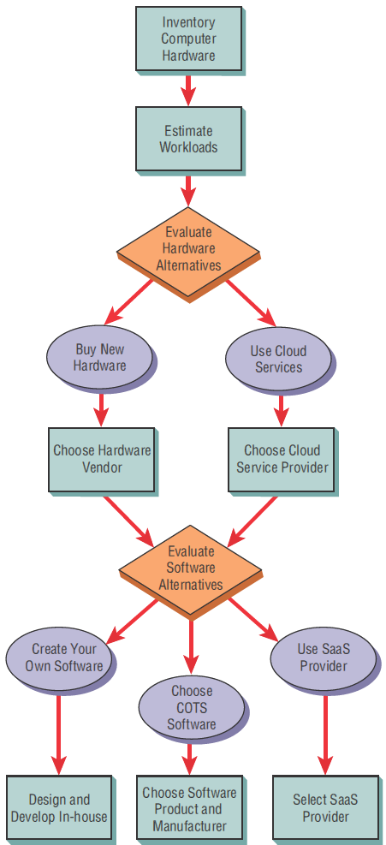
Steps in Choosing Hardware and Software
3-17

Slide 18
Inventorying Computer Hardware
Type of equipment
Operation status of the equipment
Estimated age of equipment
Projected life of equipment
Physical location of equipment
Department or person responsible for equipment
Financial arrangement for equipment (owned, leased, rented)

Slide 19
Evaluating Hardware
Time required for average transactions
Total volume capacity of the system
Idle time of the CPU or network
Size of memory provided
Criteria that the systems analysts and users should use to evaluate performance of different systems hardware:
Time required for average transactions—including how long it takes to input data and how long it takes to receive output.
Total volume capacity of the system—how much can be processed at the same time before a problem arises.
Idle time of the CPU or network.
Size of memory provided.

Slide 20
People that Evaluate Hardware
Management
Users
Systems analysts
Evaluating computer hardware is the shared responsibility of management, users, and systems analysts. Although vendors supply details about their offerings, analysts oversee the evaluation personally. Systems analysts will educate users and administration about advantages and disadvantages.

Slide 21
Acquisition of Computer Equipment
Purchasing
Using Cloud Services
Influential factors:
Initial versus long-term costs.
Can capital afford to be tied up in computer equipment.
Should the business have full control of and responsibility for the computer equipment.

Slide 22
Available cloud services
Available cloud services may include:
Web hosting
Email hosting
Application hosting
Backup
Storage and processing of databases
Archiving
Ecommerce

Slide 23
Three Main Categories of Cloud Computing
Software as a Service (SaaS)
Infrastructure as a Service (IaaS)
Platform as a Service (PaaS)

Slide 24
Strategic Cloud Computing Decisions
Decisions on cloud computing can first be addressed on a strategic level
Business should focus on the following metrics:
Availability
capacity-oriented availability,
reliability and
cost requirements
core technical requirements

Slide 25
Benefits of Cloud Computing
Less time spent maintaining legacy systems
May be simpler to acquire IT services
Scalable applications that can grow by adding more cloud resources
Consistency across multiple platforms
Capital is not tied up

Slide 26
Drawbacks of Cloud Computing
Loss of control of data stored in the cloud
Potential security threats to data that is not stored on premises
Reliability of the Internet as a platform

Slide 27
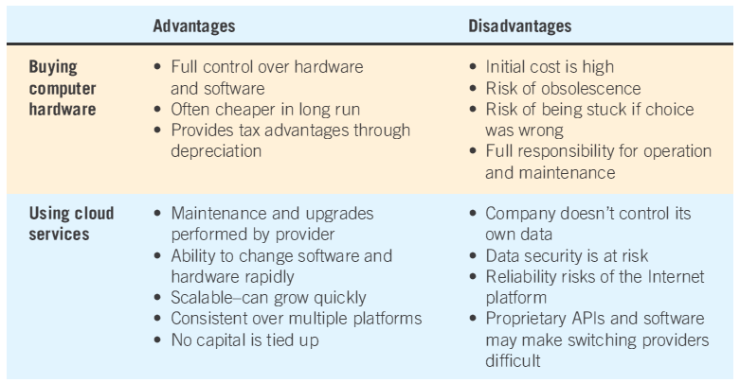
Purchasing or Using Cloud Services Advantages and Disadvantages
Notes:
Main determinants—projected life of the system.
As systems become smaller, more powerful, less expensive, and distributed systems become increasingly popular, more businesses are deciding to purchase equipment.

Slide 28
Evaluating Vendor Support
Hardware support
Software support
Installation and training support
Maintenance support
Peruse the support services documents accompanying the purchase or lease of equipment and remember to involve appropriate legal staff before signing contracts for equipment or services.

Slide 29
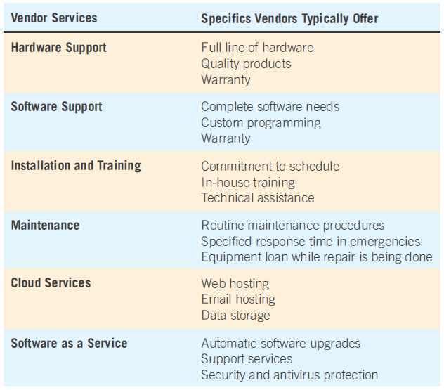
Guidelines for Vendor Selection

Slide 30
BYOD and BYOT
BYOD: Bring your own device
BYOT: Bring your own technology
Employee uses their own device access corporate networks, data, and services remotely

Slide 31
Benefits of BYOD and BYOT
Building employee morale
Potential for lowering the initial cost hardware purchase
Facilitating remote, around-the-clock access to corporate computer networks
Building on a familiar user interface to access corporate computing services, applications, databases, and storage

Slide 32
Drawbacks of BYOD and BYOT
Security risks posed by untrained users
Loss of the device
Theft of the device and its data
Unauthorized access to corporate networks using personal mobile devices

Slide 33
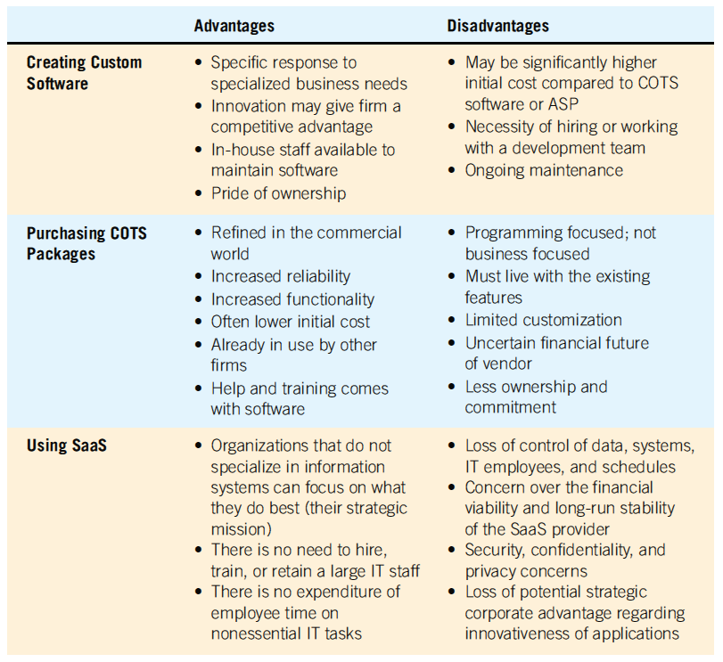
Software Alternatives
Created custom software
Purchased as COTS (commercial off-the-shelf) software
Provided by an software as a service (SaaS)

Slide 34
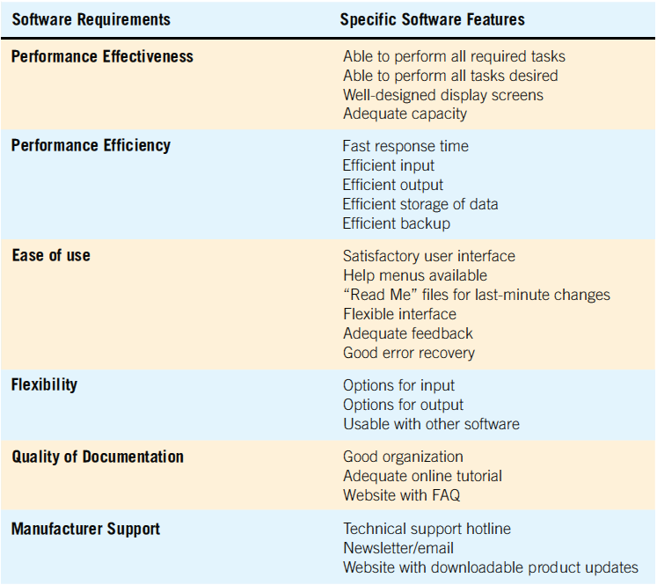
Software Evaluation
Performance effectiveness
Performance efficiency
Ease of use
Flexibility
Quality of documentation
Manufacturer support
Notes:
Evaluate packaged software based on a demonstration with test data from the business considering it and an examination of accompanying documentation.

Slide 35
Activity Planning and Control
Planning includes:
Selecting a systems analysis team
Estimating time required to complete each task
Scheduling the project
Control includes:
Comparing the plan for the project with its actual evolution
Taking appropriate action to expedite or reschedule activities

Slide 36
Identifying and Forecasting Costs and Benefits
Judgment methods
Estimates from the sales force
Surveys to estimate customer demand
Creating scenarios
Drawing historical analogies
Key things to categorise are
Tangible costs
Intangible costs
Tangible benefits
Intangible benefits

Slide 37
Identifying and Forecasting Costs and Benefits (continued)
If historical data are available
Conditional:
There is an association among variables in the model
Unconditional:
Do not need to find or identify any relationships
Conditional—correlation regression, leading indicators, econometrics, and input/out models.
Unconditional—judgment, moving average, and analysis of time series data.

Slide 38
Identifying Benefits and Costs
Tangible benefits are advantages measurable in dollars through the use of the information system
Intangible benefits are difficult to measure
Tangible costs are accurately projected by the systems analyst and accounting personnel
Intangible costs are difficult to estimate and may not be known
Both tangible and intangible cost must be taken into account when systems are considered.

Slide 39
Tangible Benefits
Advantages measurable in dollars that accrue to the organization through the use of the information system
Examples:
Increase in the speed of processing
Access to otherwise inaccessible information
Access to information on a more timely basis
The advantage of the computer’s superior calculating power
Decreases in the amount of employee time needed to complete specific tasks
Improved communication
Error reduction

Slide 40
Intangible Benefits
Intangible benefits are benefits from use of the information system that are difficult to measure
Examples:
Improving the decision-making process
Enhancing accuracy
Becoming more competitive in customer service
Maintaining a good business image
Increasing job satisfaction
Increased customer satisfaction
Notes:
Both tangible and intangible benefits must be discussed in the proposal, both will allow decision makers to make a well-informed decision about the proposed system.

Slide 41
Tangible Costs
Those that can be accurately projected by systems analysts and the business’ accounting personnel
Examples:
Cost of equipment
Cost of resources
Cost of systems analysts’ time
Cost of programmers’ time
Employees’ salaries
Notes:
These costs are well established and are the costs that require a cash outlay of the business.

Slide 42
Intangible Costs
Those that are difficult to estimate and may not be known
Examples:
Customer dissatisfaction
Losing a competitive edge
Losing the reputation of being first
Declining company image
Ineffective decision making
Notes:
It is generally not possible accurately to project a dollar amount for intangible costs.

Slide 43
Comparing Costs and Benefits
Break-even analysis
Payback
Cash-flow analysis
Present value analysis
Notes:
All these techniques provide straightforward ways of yielding information to decision makers about the worthiness of the proposed system.

Slide 44
Break-Even Analysis
The point at which the total cost of the current system and the proposed system intersect
Can be represented as Total Cost=Total Revenue
Useful when a business is growing and volume is a key variable in costs
Disadvantage:
Benefits are assumed to remain the same
Advantage:
Can determine how long it will take for the benefits of the system to pay back the costs of developing it
Notes:
Total costs = costs that recur during operation of the system + developmental costs that occur only once

Slide 45
Cash-Flow Analysis
Examines the direction, size, and pattern of cash flow that is associated with the proposed information system
Determines when cash outlays and revenues will occur for both; not only for the initial purchase, but over the life of the information system
Notes:
Cash-flow analysis is used to determine when a company will begin to make a profit and when it will be “out of the red.”

Slide 46
Present Value Analysis
Way to assess all the economic outlays and revenues of the information system over its economic life, and to compare costs today with future costs and today’s benefits with future benefits
Presents the time value of the investment in the information system as well as the cash flow
Notes:
The cost of money is the opportunity cost, or rate that could be obtained if the money invested in the proposed system were invested in another project.

Slide 47
Guidelines for Analysis
Use break-even analysis if the project needs to be justified in terms of cost, not benefits
Use payback when the improved tangible benefits form a convincing argument for the proposed system
Use cash-flow analysis when the project is expensive, relative to the size of the company
Use present value when the payback period is long or when the cost of borrowing money is high

Slide 48
Project Scheduling
Gantt Charts
Simple
Drawn to scale
MS Visio, MS Excel can be helpful in drawing them

Slide 49
Using a Two-Dimensional Gantt Chart for Planning Activities that Can Be Accomplished in Parallel

Slide 50
PERT DIAGRAMS
PERT diagrams (Project Evaluation Review Technique)
It’s a project management tool used to schedule, organize and coordinate tasks within a project. It provides a graphical representation of a project's timeline that enables project managers to break down each individual task in the project for analysis.
Lucid chart can be used to generate these diagrams
A PERT chart requires a project manager to think through three possible timelines:
Optimistic time is the shortest possible route to completion.
Pessimistic time is the longest it might take if everything goes wrong.
The most likely time is a reasonable estimate of the best-case scenario.

Slide 51
A Completed PERT Diagram for the Analysis Phase of a Systems Project

Slide 52
PERT Diagram Advantages
Easy identification of the order of precedence
Easy identification of the critical path and thus critical activities
Easy determination of slack time
More slack time means that project scheduling is more flexible.
Build slack time into your schedule to offset certain risks.
Slack time is an indicator of how flexible the timing of project work can be.
Notes:
Slack time is the amount of time that a project can be delayed without having a negative impact on the project's completion.

Slide 53
Managing the Team Project
Team management
Assembling a team
Team communication strategies
Project productivity goals
Team member motivation

Slide 54
Assembling a Team
Shared value of team work
Good work ethic
Honesty
Competency
Readiness to take on leadership based on expertise
Motivation
Enthusiasm for the project
Trust of teammates
Notes:
Experience—this could mean code is developed five times faster.
Motivation—select good people at the outset.
Enthusiasm—not only enthusiasm, but imagination and the ability to communicate with different kinds of people.
Trust—people may have different work styles, but they all need to agree to work together toward a common goal.

Slide 55
Communication Strategies
Teams often have two leaders:
Task leader: leads members to accomplish tasks
Socioemotional leader: concerned with social relationships
The systems analyst must manage:
Team members
Their activities
Their time and resources

Slide 56
The Systems Proposal
Cover letter
Title page of project
Table of contents
Executive summary
Outline of systems study with appropriate documentation
Detailed results of the systems study
Systems alternatives
Systems analysts recommendations
Summary
Appendices
Notes:
Ten main sections comprise the systems proposal.
Cover letter—should list the people who did the study and summarize the objectives of the study. Concise and friendly.
Title page of project—name of the project, the names of the team members, date submitted.
Table of contents—useful to readers of long proposals; omit if less than 10 pages.
Executive summary—precisely provides the who, what, when , where, why, and how of the proposal.
Outline of systems study with appropriate documentation—provides information about all the methods used in the study and who or what was studied.
Detailed results of the systems study—describes what was found out about human and systems needs through all the methods described in the detailed results of the systems study.
Systems alternatives—two or three alternatives that directly address the problem.
Systems analysts recommendations—the recommended solution.
Summary—brief statement that mirrors the content of the executive summary. Conclude the proposal on a positive note.
Appendices—can include any information that may be of interest.

Slide 57
Using Figures for Effective Communication
Effective use of tables
Effective use of graphs
Notes:
Integrating figures into your proposal helps demonstrate that you are responsive to the different ways people absorb information.

Slide 58
Effective Use of Tables
Integrate into the body of the proposal
Try to fit the entire table vertically on a single page.
Number and title the table at the top of the page.
Label each row and column.
Use a boxed table if room permits.
Use footnotes if necessary to explain detailed information contained in the table.
Notes:
Integrate into the body of the proposal—don’t regulate them to the appendices.
Number and title the table at the top of the page—make the title descriptive and meaningful.
Label each row and column—use more than one line for a title if necessary.
Use a boxed table if room permits—vertically ruled columns will enhance the readability.

Slide 59
Effective Use of Graphs
Choose a style of graph that communicates your intended meaning well
Integrate the graph into the body of the proposal
Give the graph a sequential figure number and a meaningful title
Label each axis, and any lines, columns, bars, or pieces of the pie on the graph
Include a key to indicate differently colored lines, shaded bars, or crosshatched areas

